Slide 1

COBOL for the 21st Century
11th edition
John Wiley & Sons, Inc.
Nancy Stern
Hofstra University
Robert A. Stern
Nassau Community College
James P. Ley
University of Wisconsin-Stout
(Emeritus)
5-<number>

Slide 2
Designing and Debugging Batch and Interactive COBOL Programs
Chapter 5
5-<number>

Slide 3
Chapter Objectives
To familiarize you with
How to design structured programs
Pseudocode
Hierarchy or structure charts
Logical control structures
Good programming techniques
Interactive processing
5-<number>

Slide 4
Chapter Contents
What Makes a Well-Designed Program?
Designing Programs Before Coding
Logical Control Structures Using Pseudocode
Hierarchy Charts for Top-Down Programming
Naming Modules or Paragraphs
Modularizing Programs
5-<number>

Slide 5
Chapter Contents
Review of Coding Guidelines
Making Interactive Programs More User-Friendly
5-<number>

Slide 6
Well-Designed Programs
Use planning tool to map program logic
Minimizes logic errors in code
Determines how all instructions interrelate
5-<number>

Slide 7
Well-Designed Programs
Are structured programs
Use instructions executed in standardized order
Divide program into modules, each performing a specific function
Control returns to place module called from
Simple PERFORM used in COBOL to execute modules (paragraphs)
5-<number>

Slide 8
Well-Designed Programs
Use top-down approach
Code modules in hierarchical order
Main modules first, then secondary modules with detailed code
Step-wise refinement
5-<number>

Slide 9
Well-Designed Programs
Are modular
Group related statements together into modules
Execute each module or paragraph in COBOL with simple PERFORM
For example, statements to calculate students’ tuition in one module, statements to calculate room and board in another module
5-<number>

Slide 10
Designing Before Coding
Design program first
  So program will work efficiently
  So program works as integrated whole
  Design techniques applicable to all languages
Code program only after design done
  Use syntax rules of language
  Syntax rules are language-specific
5-<number>

Slide 11
Pseudocode
Primary tool for planning program logic
Specifies instructions and logical control structures used by program
Use one or more lines of pseudocode to describe each program step
5-<number>

Slide 12
Four Logical Control Structures
Used by structured programs to specify order in which instructions are executed
1. Sequence
2. Selection
3. Iteration
4. Case Structure
5-<number>

Slide 13
Sequence
Instructions executed in order they appear
Three instructions below executed one after the other
START
Read Amt1, Amt2
Compute Total = Amt1 + Amt2
Write Total
STOP
5-<number>

Slide 14
Selection
Instructions executed depending on existence of a condition
Called IF-THEN-ELSE logical control structure
5-<number>

Slide 15
Selection Structure Pseudocode
IF condition
THEN
instructions to do if condition exists
ELSE
instructions to do if condition doesn’t exist
END-IF
Example
IF X is Less Than Y
THEN
Add X To Y
ELSE
Subtract X From Y
END-IF
5-<number>

Slide 16
Iteration
To specify repeated execution of series of steps
Use in-line or standard PERFORM UNTIL for iteration in COBOL
Both execute group of instructions repeatedly until a condition is met
5-<number>

Slide 17
Iteration Pseudocode
In-line PERFORM UNTIL
PERFORM UNTIL condition
.
. statements to be repeated
.
END-PERFORM
.
. Statements following PERFORM
.
5-<number>

Slide 18
Iteration Pseudocode
Standard PERFORM UNTIL
PERFORM paragraph-1 UNTIL condition
.
. Statements following PERFORM
.
Paragraph-1.
.
. statements to be repeated
.
5-<number>

Slide 19
Infinite Loops
In-line and standard PERFORM UNTIL both repeat instructions until condition met
If condition never met, loop never ends
Causes error called an infinite loop
5-<number>

Slide 20
Infinite Loops
Make sure loop ends by including instruction in loop that causes condition to be met
For example, if condition is
WS-MORE-DATA = ‘NO’
Make sure there is statement in loop that sets WS-MORE-DATA to ‘NO’ when there is no more data
5-<number>

Slide 21
Case Structure
To choose from one of several sets of instructions depending on a condition
For example, assume
  Different instructions should be executed when field Code-In has values of 1, 2 or 3
  Any other value of Code-In is considered an error
5-<number>

Slide 22
Case Structure Pseudocode
EVALUTATE Code-In
WHEN 1 PERFORM paragraph-1
WHEN 2 PERFORM paragraph-2
WHEN 3 PERFORM paragraph-3
WHEN OTHER
PERFORM error-paragraph
END-EVALUATE
5-<number>

Slide 23
Case Structure Pseudocode
Depending on the value of Code-In, the instructions in one of the paragraphs will be executed
5-<number>

Slide 24
Hierarchy Charts
To illustrate top-down relationships among modules
Graphic method to divide program into modules
Modules shown as rectangular boxes
Relationships among modules represented by connected lines
5-<number>

Slide 25
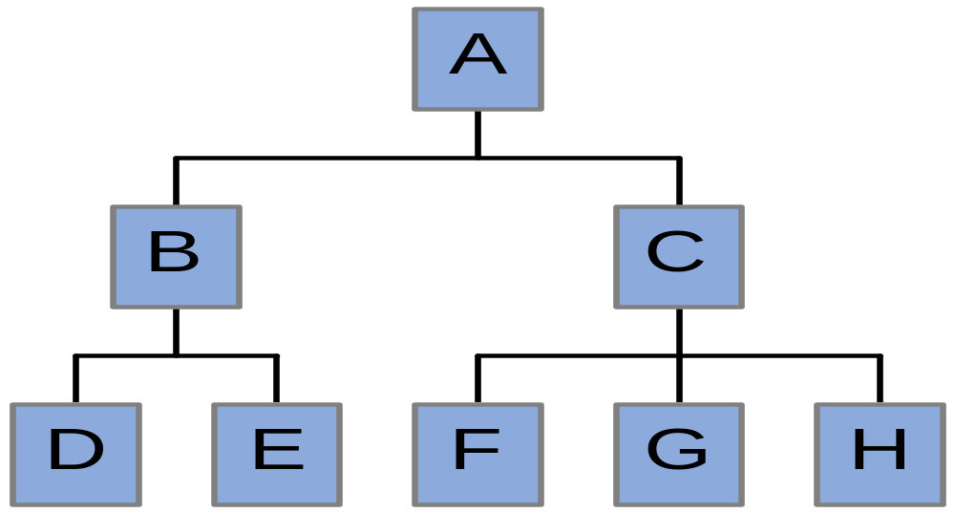
Example of Hierarchy Chart
5-<number>

Slide 26
Hierarchy Chart
Letters A-H represent modules or paragraphs
A is main module
B and C are subordinate modules called from main paragraph with a PERFORM
D and E represent modules called from paragraph B
5-<number>

Slide 27
Pseudocode and Hierarchy Charts
Pseudocode shows actual sequence of instructions
Hierarchy charts show relationships among modules
Both help programmers
  Develop efficient programs
  Debug and modify programs
5-<number>

Slide 28
Naming Paragraphs
Name up to 30 characters - letters, digits, hyphen
Choose meaningful name that describes type of instructions in module
Use numeric prefixes to indicate relative location of module in program
Examples
100-Main-Module 200-Process-Data
5-<number>

Slide 29
Coding Guidelines Review
Code each clause on separate line
  Program easier to read
  Easier to isolate errors since compiler identifies errors by line
Indent clauses within a statement
  Makes program easier to read
  Does not affect program logic but makes it easier to see
5-<number>

Slide 30
Coding Guidelines Examples
Select Inventory-File
Assign to Disk1
Organization Is Line Sequential.
Read Inventory-File
At End
Move ‘NO’ to WS-More-Data
Not At End
Perform 200-Process-Record
End-Read
5-<number>

Slide 31
Scope Terminators
Use with PERFORM UNTIL (END-PERFORM), READ (END-READ), and others discussed later
Minimizes logic errors by ensuring all clauses associated with correct statement
Do not use periods to end statements except last statement of paragraph
5-<number>

Slide 32
User-friendly Interactive Programs
Anticipate user responses different from those expected
In response to prompt 'Is there more data?' user may enter 'YES', 'Y' or 'yes'
- 'Y' does not equal 'YES'
- 'yes' does not equal 'YES' because
lowercase and uppercase letters not
equal
5-<number>

Slide 33
User-friendly Interactive Programs
Modify condition to accept variations
Perform Until WS-More-Data = ‘YES’ Or
‘yes’ Or ‘y’
Make prompt for input as specific as possible
‘Is there more data(YES/NO)?’
Build in flexibility when accepting data (methods discussed in later chapters)
5-<number>

Slide 34
Syntax Errors
Compiler translates your COBOL code into machine language
Checks for rule violations or syntax errors while translating
  For example, misspelling a reserved word
Must be corrected before program can be executed
5-<number>

Slide 35
Logic errors
Detected during execution of program
May be due to
  Coding order of instructions incorrectly
  Coding incorrect instruction for desired result
5-<number>

Slide 36
Debugging
Process of eliminating both syntax and logic errors from program
Syntax errors detected by compiler during compilation
Logic errors not detected until program executed
5-<number>

Slide 37
Levels of Syntax Errors
Severe - error must be corrected to complete program compilation
Intermediate - compiler makes assumptions about how to correct error and continues
Minor - compilation can be completed but there may still be logic errors
5-<number>

Slide 38
Identifying syntax errors
Error may be caused by line above one indicated by compiler
One error may generate multiple error messages
Severe errors may prevent entire sections from compiling
  When error fixed, even more errors appear because more of program checked
5-<number>

Slide 39
Common Syntax Errors
Misspelling data-names
Defining Employee-File in SELECT entry but using Employ-File in FD
Defining Amt1 in DATA DIVISION but referring to it as Amount1 elsewhere
5-<number>

Slide 40
Common Syntax Errors
Using same data-name more than once
All file, record names must be unique
Field names must be unique unless data-name is qualified when used in PROCEDURE DIVISION
Program-name, paragraph names must be unique
5-<number>

Slide 41
Common Syntax Errors
Using reserved word for user-defined name
  Use reserved word only for its designated purpose
  See Syntax Guide for complete list
Misspelling reserved words
  Spelling PERFORM as PERFROM
5-<number>

Slide 42
Common Syntax Errors
Using nonnumeric field in arithmetic statement
Omitting scope terminators
Using letter "oh" instead of zero
5-<number>

Slide 43
Run-time Logic Errors
First make sure all syntax errors fixed
Run-time error stops program or causes program interrupt
Must be corrected before execution can continue
5-<number>

Slide 44
Common Run-Time Logic Errors
Performing arithmetic operation with field containing nonnumeric characters
Incorrect name, path or device-name for input file in ASSIGN clause
No way provided to stop PERFORM UNTIL loop
5-<number>

Slide 45
Common Logic Errors in Output
For PC users, failing to define file as ORGANIZATION IS LINE SEQUENTIAL
PERFORM UNTIL loop executed one too few or one too many times
Scope terminator not in correct location
5-<number>

Slide 46
Detecting Logic Errors in Output
Prepare complete test data
Include test data values
  That meet each condition
  That do not meet conditions
5-<number>

Slide 47
Detecting Logic Errors in Output
Perform structured walkthrough
  Determine what results should be produced
Run program
Compare computer-produced results to expected results
5-<number>

Slide 48
Debugging Tools
Debugging program provided with compiler
Use DISPLAY statement to display contents of fields at key locations in program
5-<number>

Slide 49
Chapter Summary
Logical Control Structures
  Sequence
  Selection or IF-THEN-ELSE
  Iteration with PERFORM UNTIL loop
  Case Structure
Program Planning Tools
  Pseudocode
  Hierarchy charts
5-<number>

Slide 50
Chapter Summary
Name modules using description name and numeric prefixes
Well-Designed Program Uses
  Structured programming techniques
  A modularized organization
  A top-down approach
  Meaningful field and paragraph names
  One clause per line
  Indented clauses within a statement
5-<number>

Slide 51
Chapter Summary
Interactive Processing
  Use ACCEPT to input data from keyboard
  Use DISPLAY to output information to screen
Debugging
  Correct all syntax errors
  Create complete set of test data
5-<number>

Slide 52
Copyright © 2003 John Wiley & Sons, Inc. All rights reserved. Reproduction or translation of this work beyond that permitted in Section 117 of the 1976 United States Copyright Act without the express written permission of the copyright owner is unlawful. Request for further information should be addressed to the Permissions Department, John Wiley & Sons, Inc. The purchaser may make back-up copies for his/her own use only and not for distribution or resale. The Publisher assumes no responsibility for errors, omissions, or damages, caused by the use of these programs or from the use of the information contained herein.
5-<number>

